Slide 1
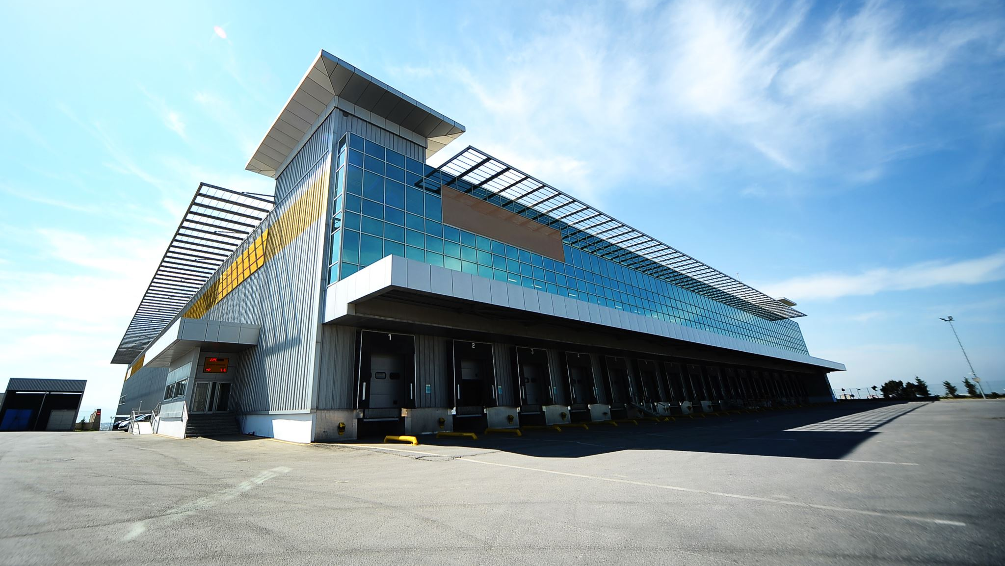
Real Estate Presentation

Slide 2
Problem Statement
- We want to advertise property and want to determine the best model that can predict the sale price of the house as accurately as possible
- We also want to determine which neighborhood has the most impact on the model we build.

Slide 3
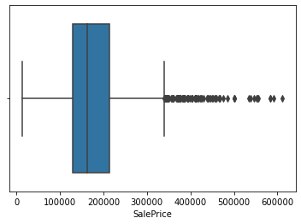
Exploratory Data Analysis/Outliers

Slide 4
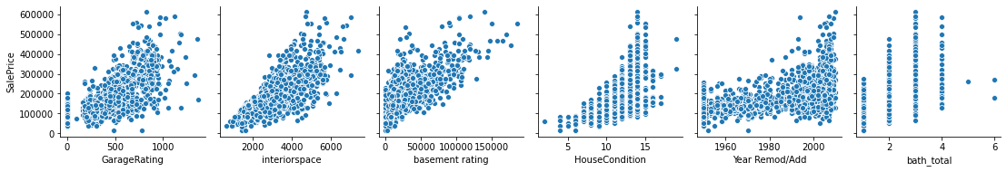
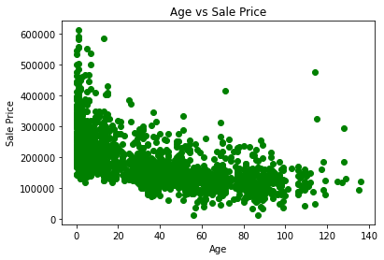
Best Correlations
Inferences

Slide 5
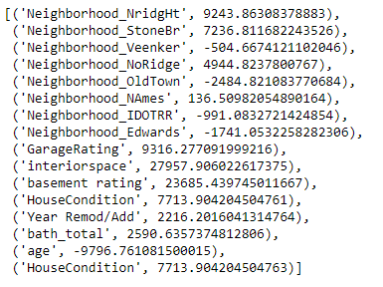
Results

Slide 6
Conclusions/Recommendations
Neighborhoods with the highest impact on the model
Stone Bridge
North Ridge
North Ridge Heights
Other Important Variables with significant impact
Interior space
Basement Rating
House Condition

